Slide 1
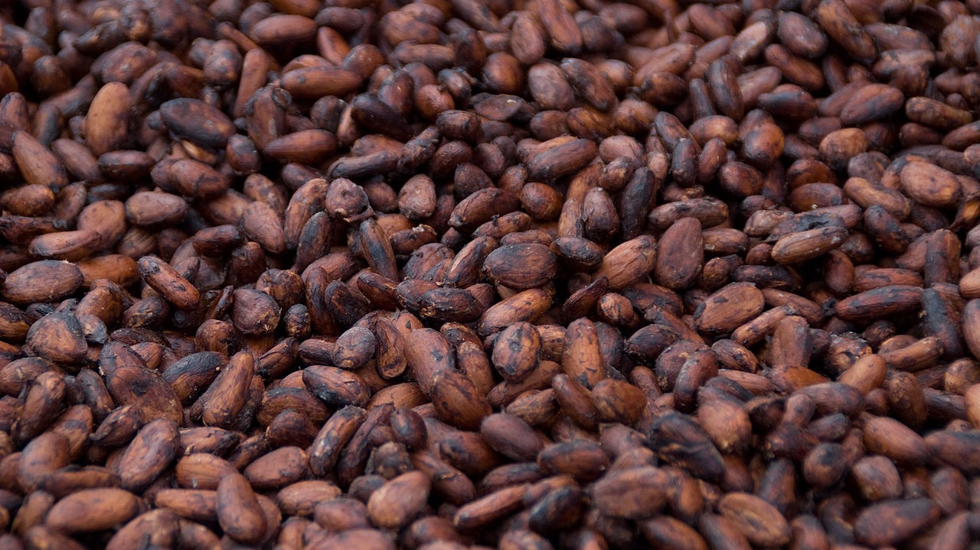
The Story of Chocolate

Slide 2
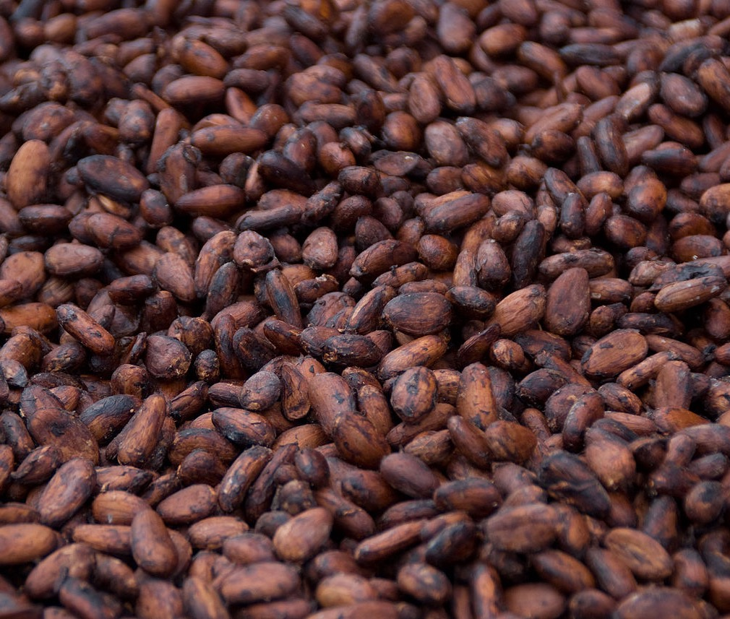
Did you know?
One of the main ingredients of chocolate is a bean?
Can you guess
which bean it is?

Slide 3
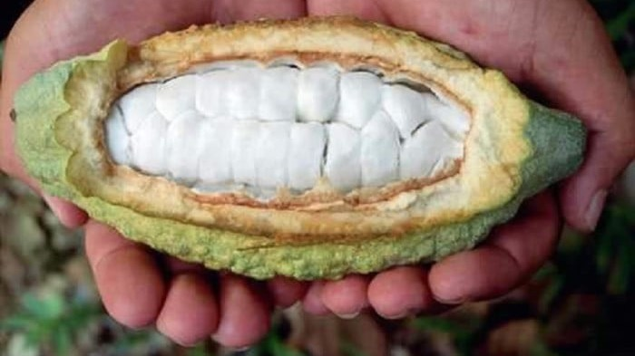
It’s the Cocoa Bean!

Slide 4
What’s your favourite type of chocolate?

Slide 5
Today we will learn
How chocolate is made
How we can make chocolate even better!

Slide 6
https://www.youtube.com/watch?v=Khdz2Stp2ZQ

Slide 7
This is how cocoa is used to make the chocolate that we enjoy!
Most of the worlds chocolate is produced with these cocoa products in Europe
Cocoa is harvested by cocoa farmers in countries such as the Ivory Coast and Ghana, Africa
The cocoa beans are purchased from the farmers and processed nearby
Here in Australia and New Zealand, we get to enjoy the delicious varieties of chocolate made from this cocoa

Slide 8
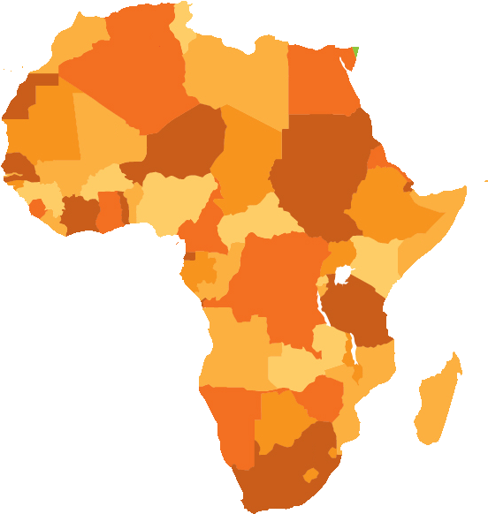
That’s not a lot!
With this income farmers need to:
1. provide food for their families
2. hire staff to work on their farms
...as well as pay or all of the other daily expenses.
Because the price of cocoa in The Ivory Coast and Ghana is so low, the farmers who produce the cocoa often live in poverty.
But there’s a problem in the process of making our delicious chocolate.
The average daily income of a cocoa famer in Ghana is only 82
Cents!
The average daily income of a cocoa famer in The Ivory Coast is only 54 cents

Slide 9
So what can we do to help?
When we look at how much cocoa farmers earn from each bar of chocolate, we think we might have a clue as to how we can help.

Slide 10
Let’s consider this chocolate bar

Slide 11
35%
The shops that sell us chocolate take a share of the chocolate bar

Slide 12
33%
The chocolate makers earn a third of the profits of the chocolate bar

Slide 13
26%
Approximately a quarter of the profits go to other businesses and governments to help make the chocolate that we love.

Slide 14
Compared to the whole block,
it doesn’t leave much for the
cocoa farmers

Slide 16
So what do some cocoa farmers do when they don’t earn enough money to run their farm?

Slide 17
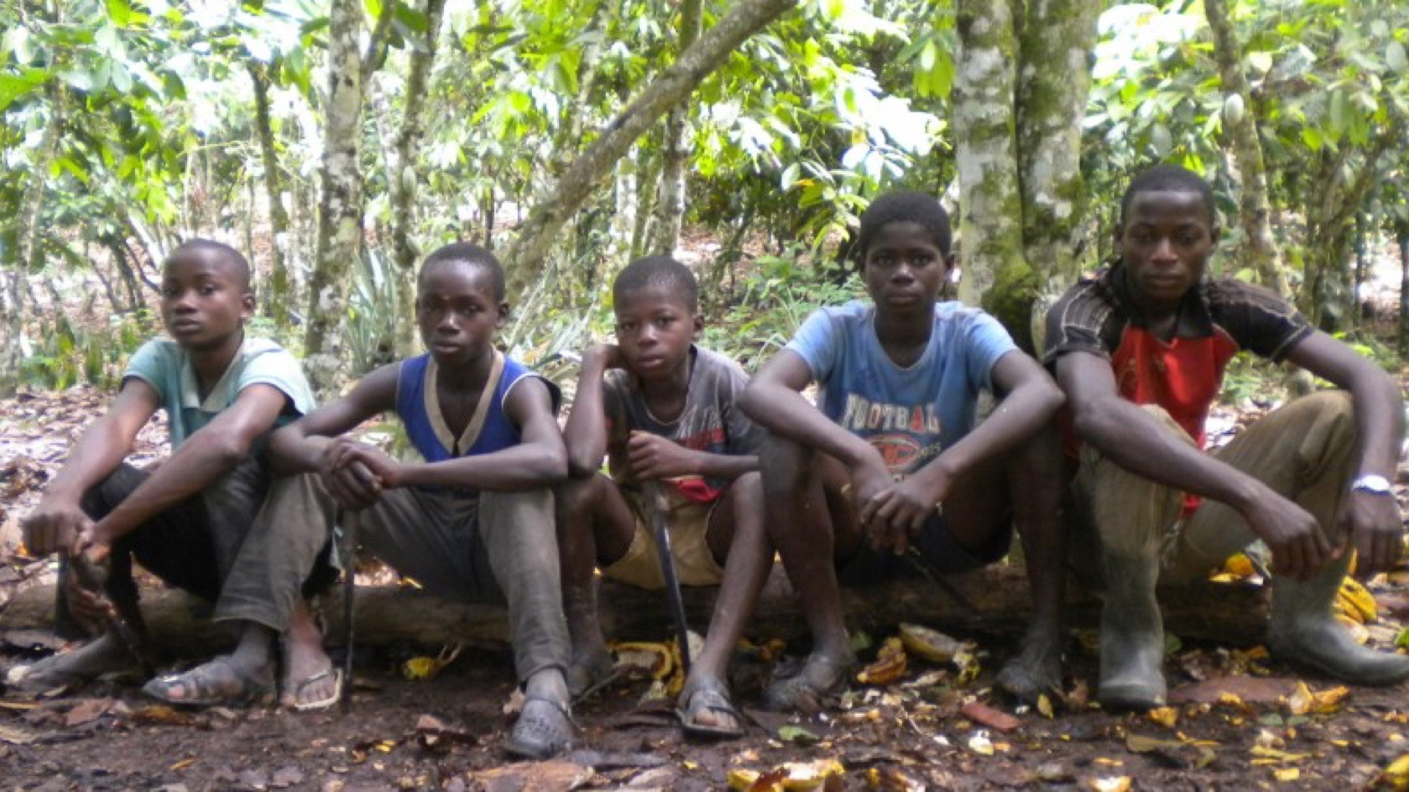
The sad truth is that sometimes, children are forced to work on cocoa farms, like Karim from Burkina Faso.

Slide 18
Karim’s
Story

Slide 19
So what can we do to help?

Slide 20
Individual Activities
Pamphlet Create a pamphlet based on what you have learned, to share information about cocoa farming with others. | Create Create an original play, poem or song about Karim's story. | Judge Use a t-chart to explore the positives and negatives of eating chocolate. Consider cocoa farmers, healthiness and enjoyability | Postcard or letter Pretending that you are a cocoa farmer, design and complete a postcard to send from Ghana to New Zealand.
Illustration Create an illustration of the process of turning cocoa beans into chocolate. | Interview Imagine that you have the opportunity to interview Karim, write 10 questions that you would like to ask him. | Infographic Create an infographic to demonstrate how much a cocoa farmer will earn from a block of chocolate | List Create a list of all the resources that a cocoa farmer needs to harvest cocoa.

Slide 21
Team Activity Write a letter to a chocolate maker
Become an advocate and speak up for farmers to receive a living wage so that they can bring themselves out of poverty, and to remove children like Karim from working on cocoa farms.

